Slide 1
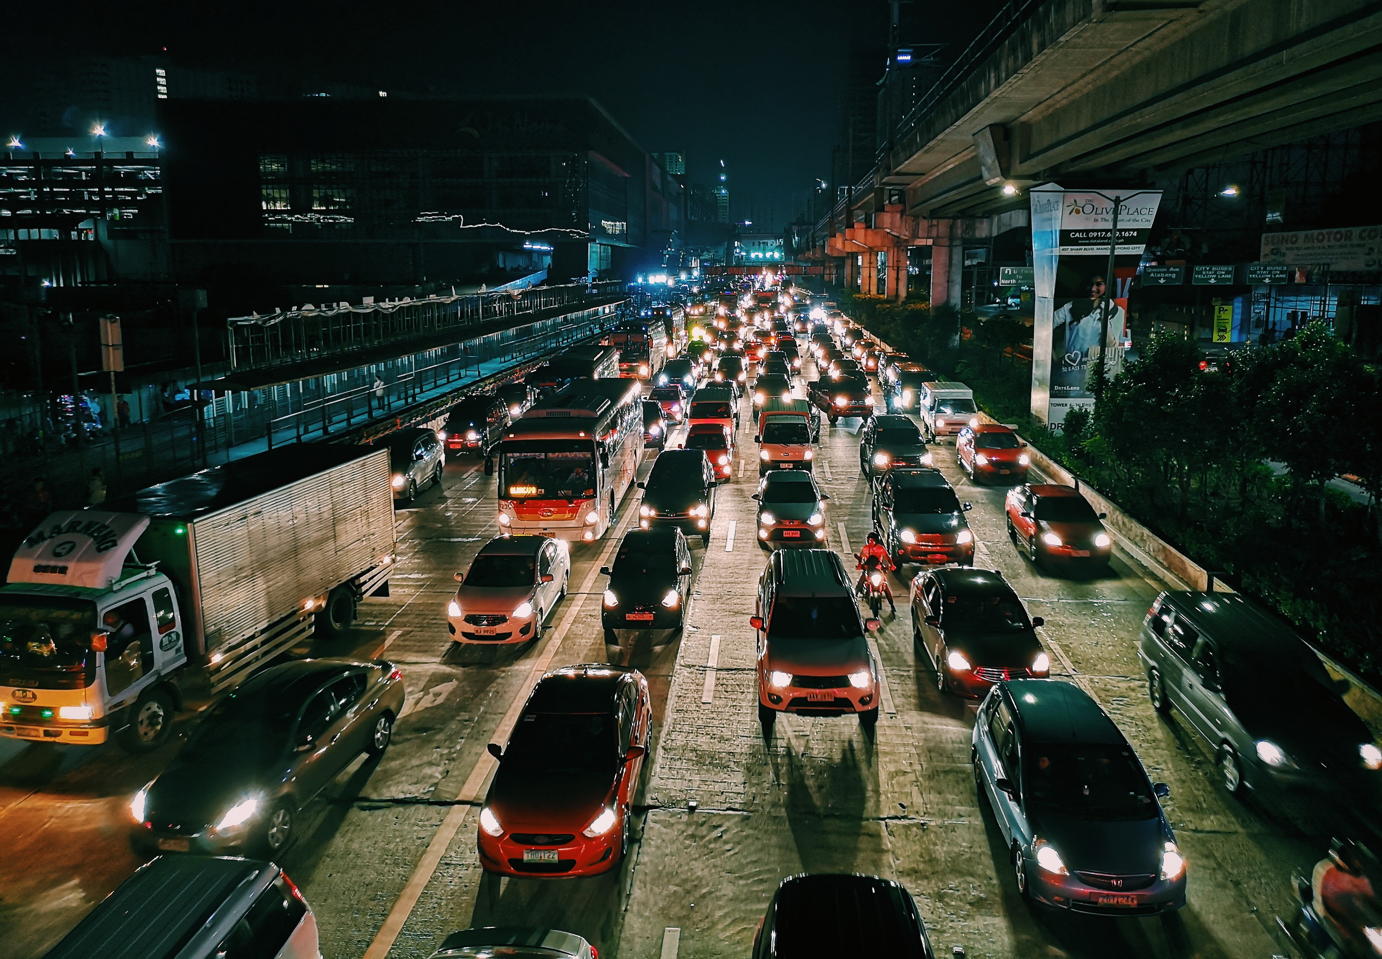
AI-Based Traffic Volume Prediction System
Name: Parminder Singh
Roll No: 22CS2030
Supervisor Name: Dr. Akash Yadav

Slide 2
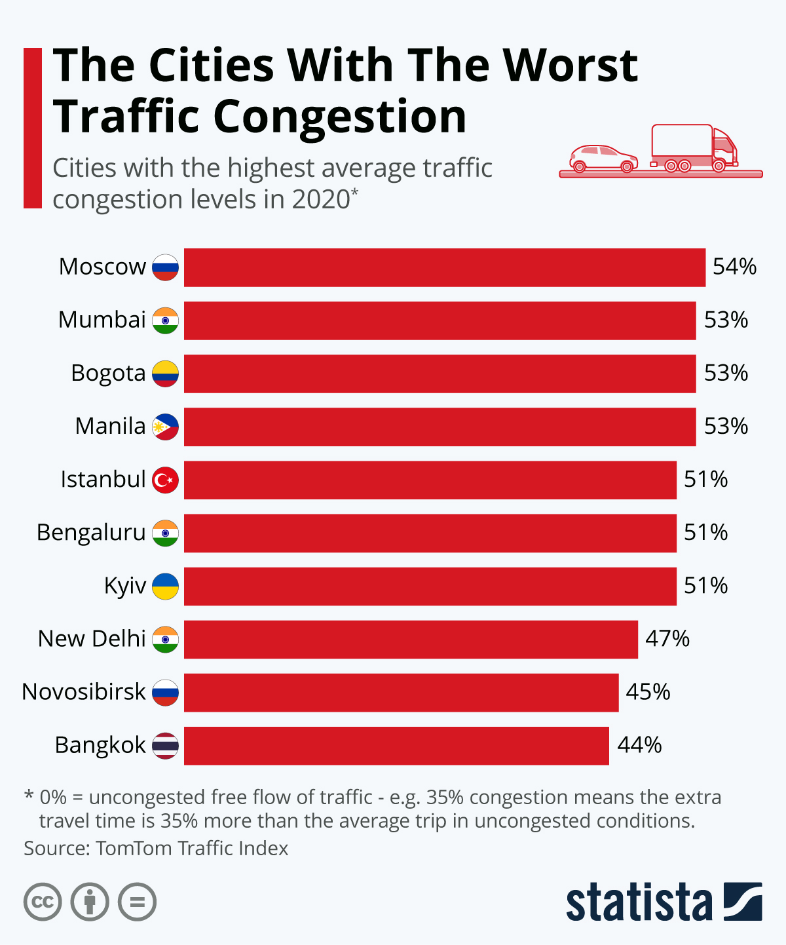
Problem DEFINITION
The PROBLEM
Existing solutions
limitations
Urban areas face severe traffic congestion, leading to:
Increased fuel consumption.
Longer commute times.
Environmental damage.
Google Maps and similar platforms suggest routes based on current traffic conditions but do not account for future traffic or spread traffic dynamically.
Ineffective congestion management during sudden incidents (e.g., accidents).

Slide 3
Solution
Our Approach
Key Features
Future traffic prediction
based on historical data.
Crowdsourced data
integration for potholes and
hazards.
Real-time updates
available via a mobile app.
Predict future traffic
conditions using machine
learning and suggest
optimal routes dynamically.
Provide real-time alerts for
sudden changes (e.g.,
accidents, potholes).
Suggest speed
adjustments to avoid
congestion.

Slide 4
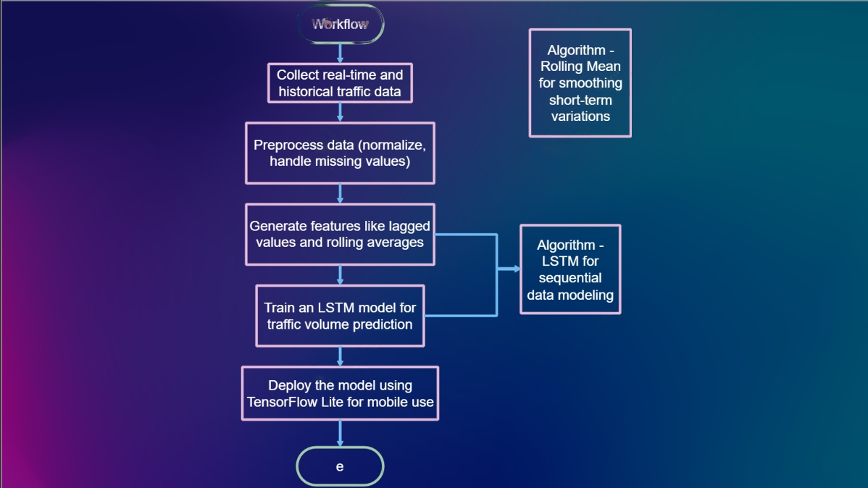


Slide 5
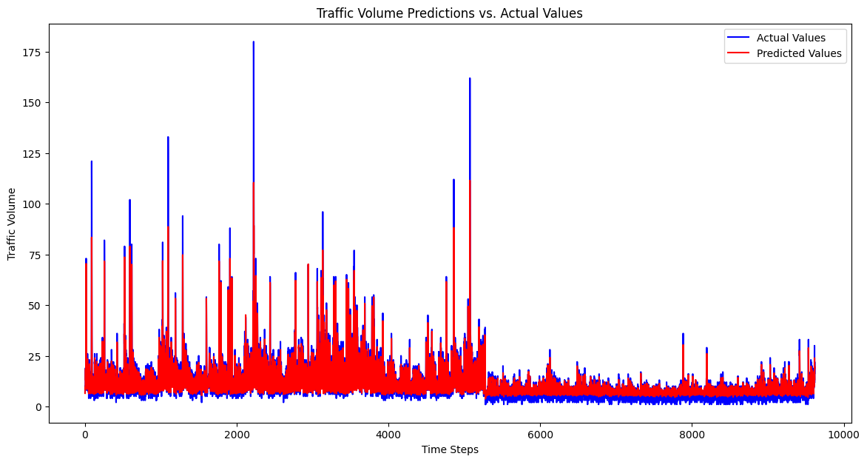
Results and Progress
Data Preprocessing (cleaning, normalization).
Feature Engineering (lagged features, rolling mean).
Model Training (LSTM model with ~79% accuracy).
Backend API for predictions.
Modules Completed
Evaluation metrics
Mean Squared Error (MSE): 6.5455
Mean Absolute Error (MAE): 1.5171
Mean Absolute Percentage Error (MAPE): 0.2116
Model Accuracy: 78.84%

Slide 6
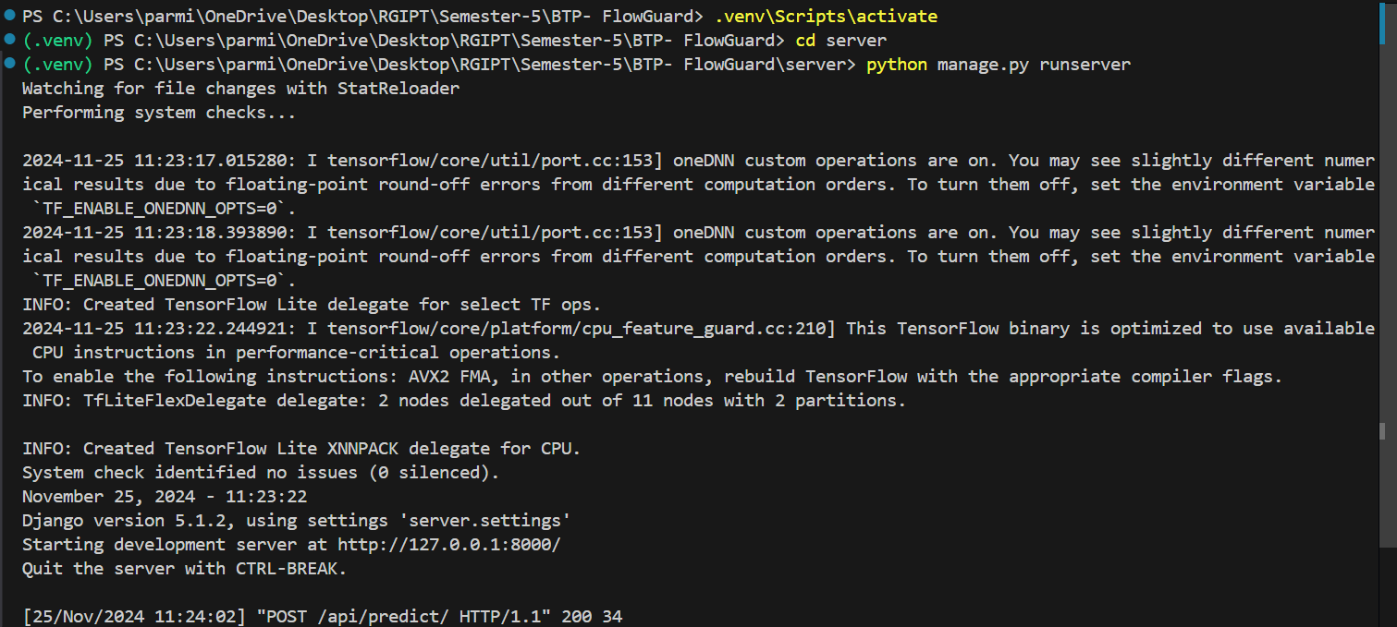
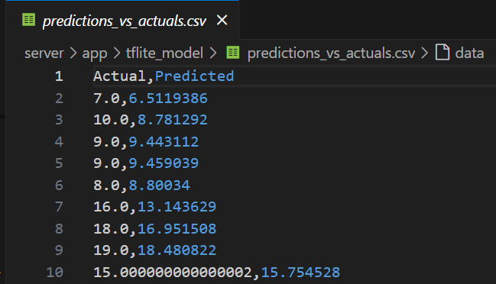
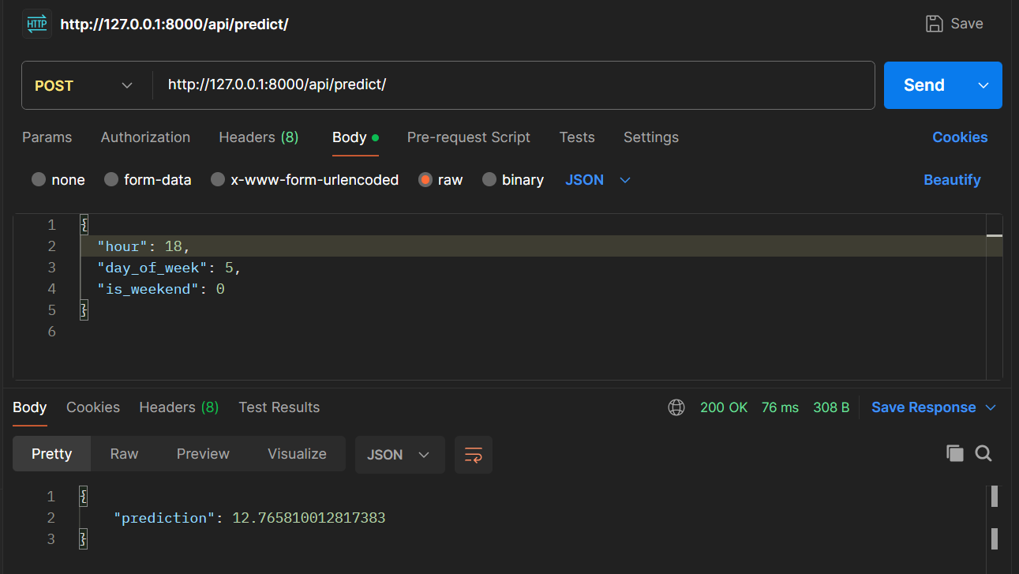
results

Slide 7
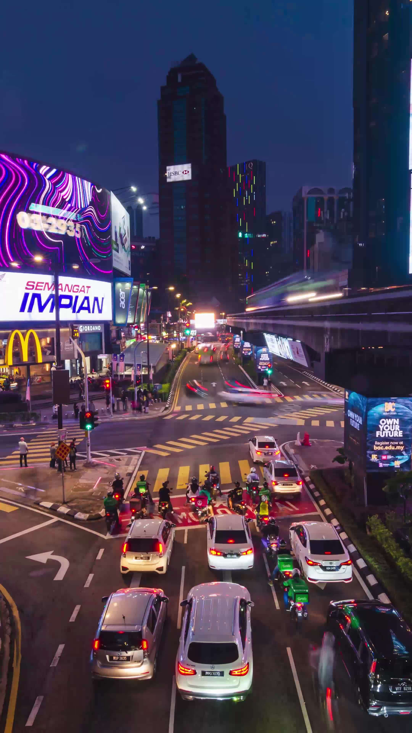
Future goals
Integrate real-time traffic data from APIs.
Enhance the LSTM model with advanced techniques:
Develop a React Native mobile app with real-time notifications.
Deploy TensorFlow Lite model on edge devices.
Next steps
Provide users with personalized traffic insights.
Minimize urban congestion and environmental impact.
vision

Slide 8
Thank you

